Slide 1
Twitter Debate of US Senators on 'Abortion Law and Policy‘ 2022
SICSS-Aachen-Graz 2022
Martin Faschingbauer, Anna Pavlova,
Olefir Nikita, Muhammad Zahidul Islam Miaji

Slide 2
OUTLINE OF THE PRESENTATION
01
04
02
05
SICSS-Aachen-Graz 2022
Research Motivation
Research Findings
Data Processing & Methods
Research Limitations
03
Results
06
Research Prospects

Slide 3
RESEARCH MOTIVATION
SICSS-Aachen-Graz 2022
The issue related to the person’s identity & covers sensitive social problem and rise conversation on a web;
Senators are the key policymaker & they are dealing with public sentiment. So their twitter opinion is a big factor to stimulate or shape public opinion.
It is seen from the related articles of Killian and Wilcox (2008) that regulation of abortion politics connected with party affiliation. The topic is crucial for a sense of belonging, whereas the case of US as one of the most politically polarized societies seems relevant for study.
“Pro-life Democrats were significantly more likely than other Democrats to become Republicans, but pro-choice Republicans were not likely to become Democrats” (Killian and Wilcox 2008, 561)
Notes:
Killian, M., & Wilcox, C. (2008). Do abortion attitudes lead to party switching?. Political Research Quarterly, 61(4), 561-573.

Slide 4
RESEARCH MOTIVATION
SICSS-Aachen-Graz 2022
Research Aim is to investigate what kind of political conversation arises from both party members in relation to #abortion policy 2022
Research Question: What US senators claim about abortion policy? What is a revealed sensitive connotation of their words in the Twitter social media platform?

Slide 5
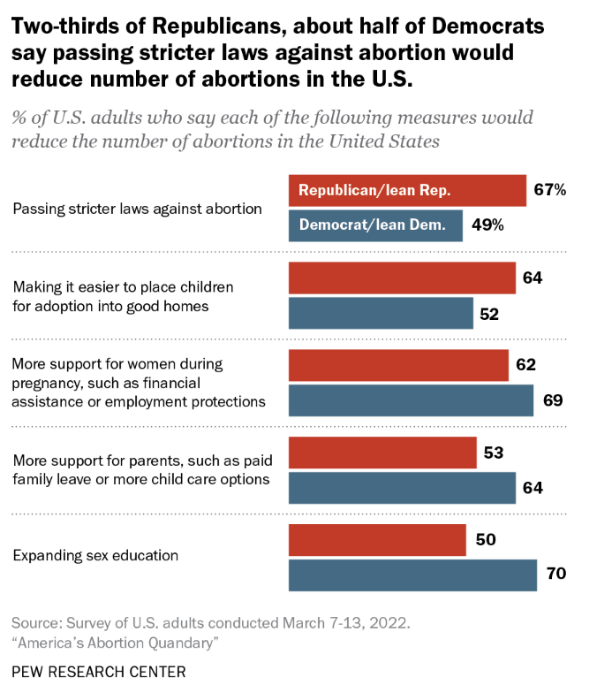
RESEARCH MOTIVATION
SICSS-Aachen-Graz 2022
Hypothesis 1:
Democrats would differ in their sentiments from Republicans concerning the topics related to abortion.
Hypothesis 2:
Democrats would most probably speak positively about right of abortion, while Republicans are negatevily againts it.
Motivation for a hypothesis:
Pew Research Center shows a different extent of political view cohesion within two party representatives
Notes:
https://www.pewresearch.org/fact-tank/2022/06/23/americans-differ-by-party-age-over-ways-to-reduce-the-number-of-abortions-in-the-u-s/

Slide 6
DATA PROCESSING & METHODS
keywords:
abortion
abortion
pregnancies
pregnancy
pregnant
unborn
embryonic
pro choice
pro life
prochoice
prolife
roevwade
roe v wade
right to life
righttolife
infanticide
parenthood
abortions
embryo
contraception
ultrasound
planned parenthood
reproductive
ultrasounds
SICSS-Aachen-Graz 2022
Data sample:
tweets by US senators in the period from May 24th to July 24th
Twitter API v2: twarc2.11.1 , Twitter API tools: Tweet downloader
Sentiment Analysis: vaderSentiment 3.3.2
Notes:
US Supreme Court’s decision to overturn Roe v. Wade - 24 June 2022

Slide 7
DATA PROCESSING & METHODS
keywords:
abortion
abortion
pregnancies
pregnancy
pregnant
unborn
embryonic
pro choice
pro life
prochoice
prolife
roevwade
roe v wade
right to life
righttolife
infanticide
parenthood
abortions
embryo
contraception
ultrasound
planned parenthood
reproductive
ultrasounds
SICSS-Aachen-Graz 2022
WORKFLOW
step1: preparation
literature research on US abortion policy, social media, ect.
identifying relevant twitter search terms on topic and timeframe
get twitter-handles of members of US Congress (100)
step2: data collection
download of tweets using the Twitter API v2 (twarc2.11.1, Twitter API tools: Tweet downloader )
step3: calculations and analyses
computing sentiment-scores using vaderSentiment 3.3.2
matching senators’ metadata and tweets
hypothesis testing using descriptive statistics, one-way anova and visualisations
Notes:
US Supreme Court’s decision to overturn Roe v. Wade - 24 June 2022

Slide 8
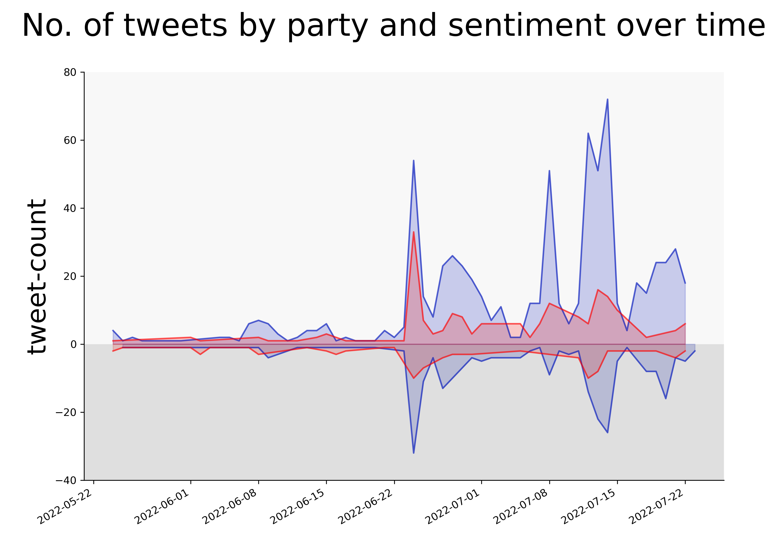
SICSS-Aachen-Graz 2022
RESULTS
tweets:
1331 by 81 senators (out of 100)
DEM: 1008 - REP: 318 - IND: 5
sentiments
overall positive in Party-subgroups
sign. difference between DEM and REP (F(2, 1328) = [12.345], p < 0.01) DEM show higher mean sentiment scores
tweets & sentiment category
No. of tweets reflect important political events in the topic
Notes:
ANOVA - not normally distr but equal variances could be assumed as levene stest were ns.
1st. Peek: US Supreme court decision on 24th June
2st. Peek: 7.July - Biden sign document reladed - medical reason for abortion
3st. Peek: 15.July - House passes bills to codify abortion rights and ensure access

Slide 9
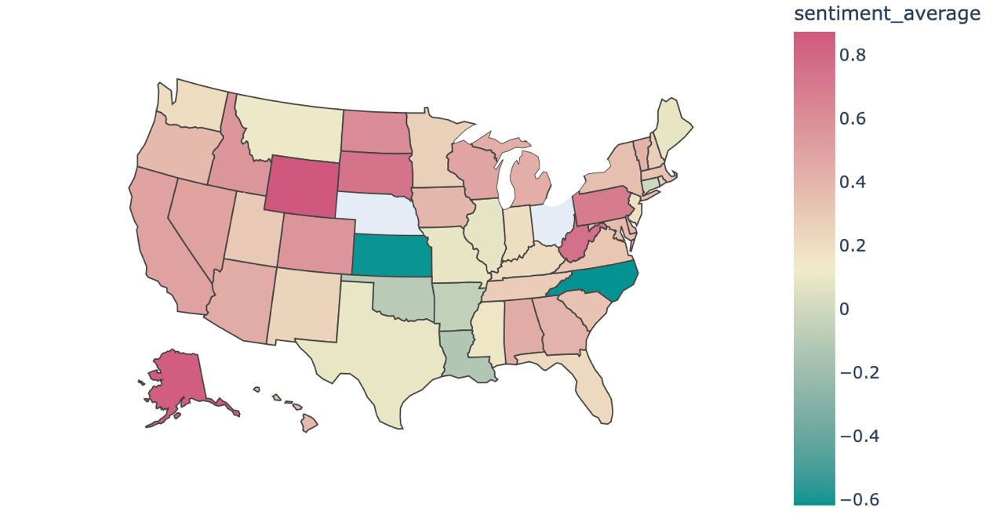
SICSS-Aachen-Graz 2022
RESULTS : CHOROPLETH MAP

Slide 10
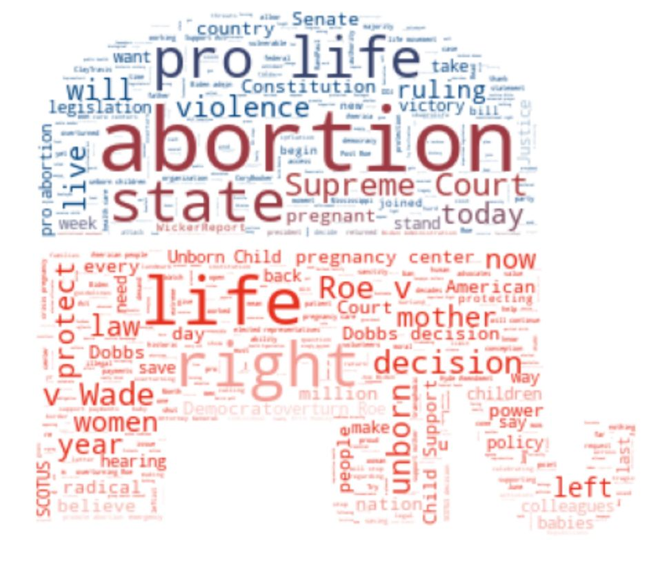
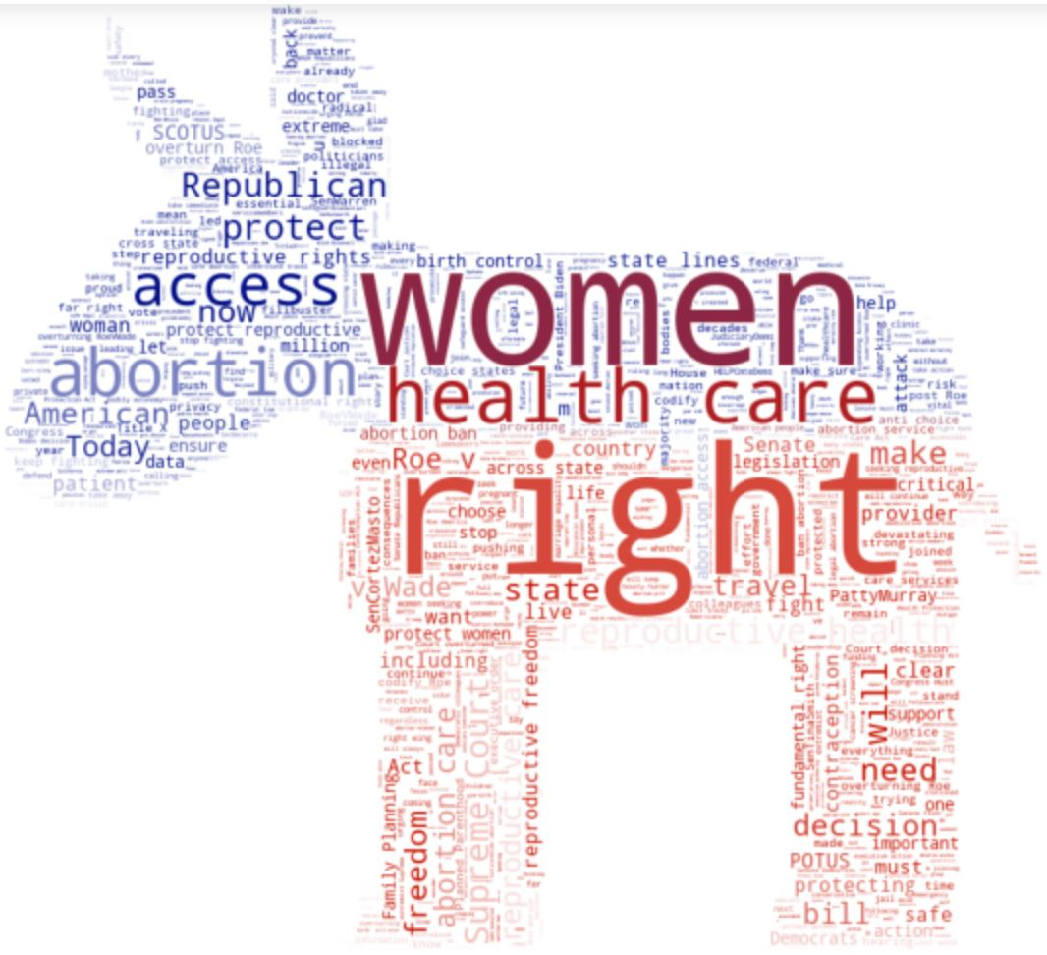
SICSS-Aachen-Graz 2022
RESULTS : WORDCLOUDS

Slide 11
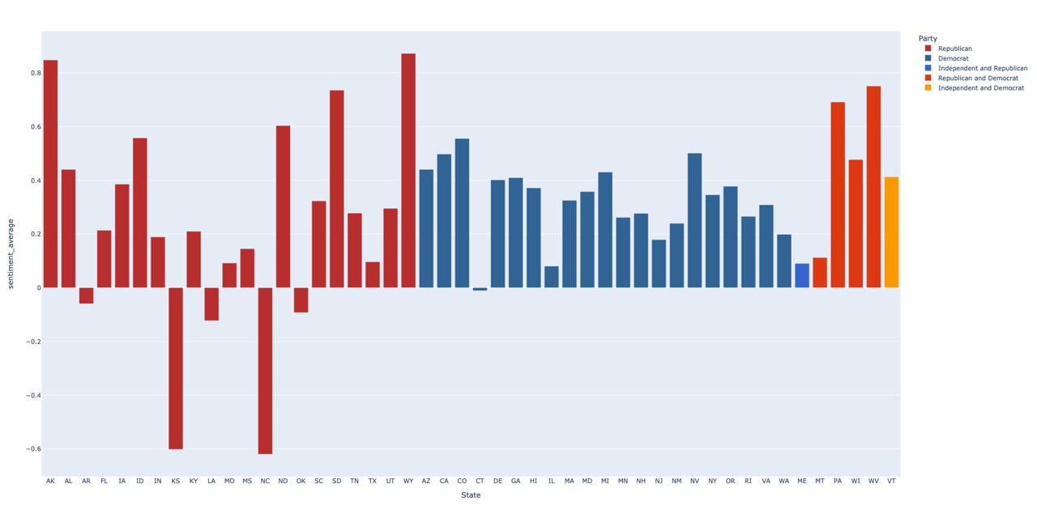
SICSS-Aachen-Graz 2022
RESULTS : BAR CHART

Slide 12
SICSS-Aachen-Graz 2022
RESEARCH FINDINGS
In general negative and positive attitudes around #abortion motivated by variety of subtopics that the one could reply on. Moreover, the objects of tweets produced by Republicans and Democrats differentiate. Republicans speak about abortion negatively in general, while democrats feel negative to limitation of the abortion policy and reproductive rights. Sentiments of tweets also depend on relative topic of respective parties.
The significant words of the parties state important clue of their party agendas, we could interpret them in a way of narratives used by party members.

Slide 13
SICSS-Aachen-Graz 2022
RESEARCH LIMITATIONS
We do not have API data for Nebraska & Ohio states;
Do not know exactly in relation which #abortion key word the sentiment was revealied by congressmen. Then, it is hard to decide about which subtopic of abortion they spoke;

Slide 14
SICSS-Aachen-Graz 2022
RESEARCH PROSPECTS
To do topic modelling of political conversation in the twitter;
To estimate whether the congress member from a certain state impacts on a conversation that arises in her/his represented state;
To analyse the effect of abortion policy on a party affiliation during Presidential elections;
Network analysis of party representatives #following and #followed_by to enrich hypothesis of a filter bubble effect;

Slide 15

THANK YOU!
SICSS-Aachen-Graz 2022
Contact Our Team:
aipavlova_2@edu.hse.ru
miaji.zahid@kdis.ac.kr
naolefir@edu.hse.ru
martin.faschingbauer@student.tugraz.at
GIT repository:
https://github.com/faschmar/ SICSS-2022-US_abortion_policy_on_twitter

